Slide 1
Programming for the People
Engaging Customers in Adult & Family Programs Through Community and Market Driven Data

Slide 2

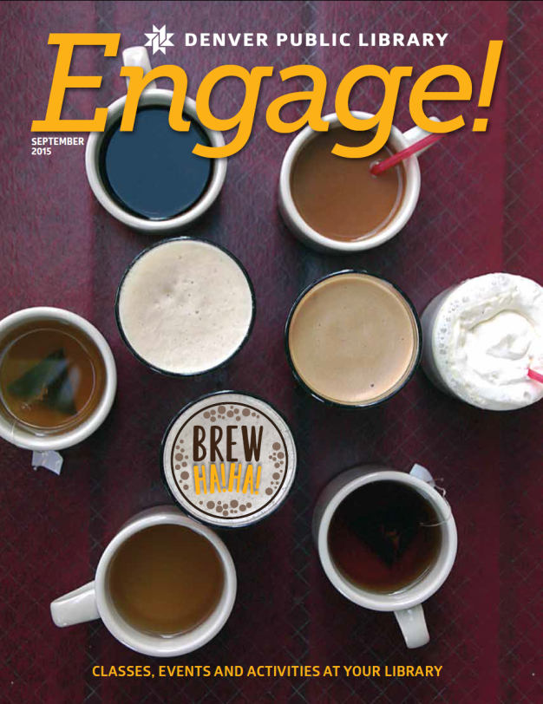
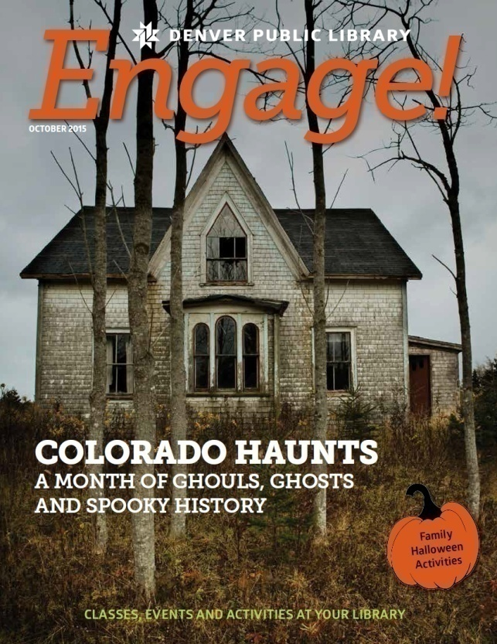
The Who & Why
Mission: “Engage adults and family audiences in fulfilling, dynamic, and unexpected experiences.”
Notes:
Who we are
[30 second snapshot of how we came to be]
Why the Engage Team exists
To strategize around the program on a larger, more system-wide level
Marketing segmentation > Action Plans
More libraries wanted to add Adult and Family programming to attract their segments
Labor intensity of programming for so many branches
To combat siloing
Rapid growth of program = need for quality control

Slide 3
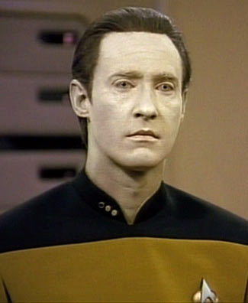
Fun With Data!
Notes:
Think about your desired outcomes.
Ways to evaluate success of programs: price per person, attendance per event, attendance per category of event, target audience reached, anecdotes/heartwarming tales. Human impact.
-Image source: https://www.flickr.com/photos/net2/15885378031

Slide 4
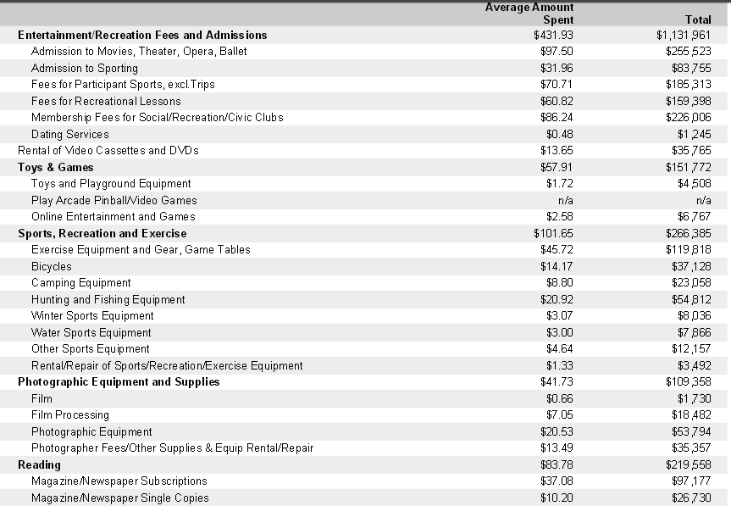
Business Decision: https://www.denverlibrary.org/research-topics/117
Notes:
Free access for you through Denver Public Library, if your library does not have this one!
The link above will also give you access to the Landscape Segmentation Resource Manual (demographics and preferences for each market segment) and PopStats Data Resource Manual (the methodology used to arrive at their statistics).
BusinessDecision will give you basic demographics, Census data, and spending habits for an area that you define. The report remains accessible there in the future—you can also download the reports that you choose to run.

Slide 5
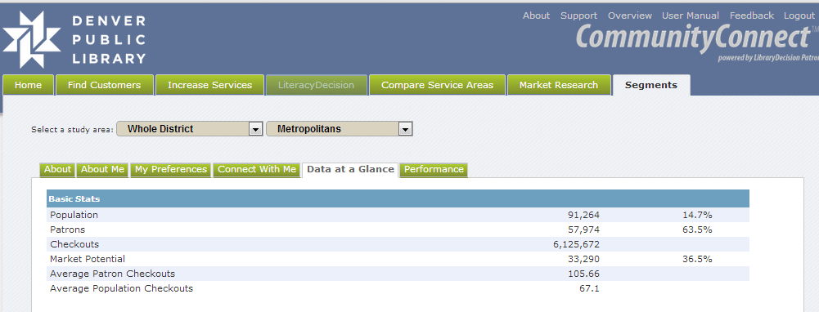
Notes:
CommunityConnect: also from CivicTechnologies. This one is only useful to your library if you purchase this product, but you can see how it works here (somewhat similar to BusinessDecisions). We can look at the demographics of who is coming to our libraries, and who is in our neighborhood but not coming in (including the percentages of each group—so we can see our market potential within each demographic). We can run new reports monthly to see how things are shifting.

Slide 6
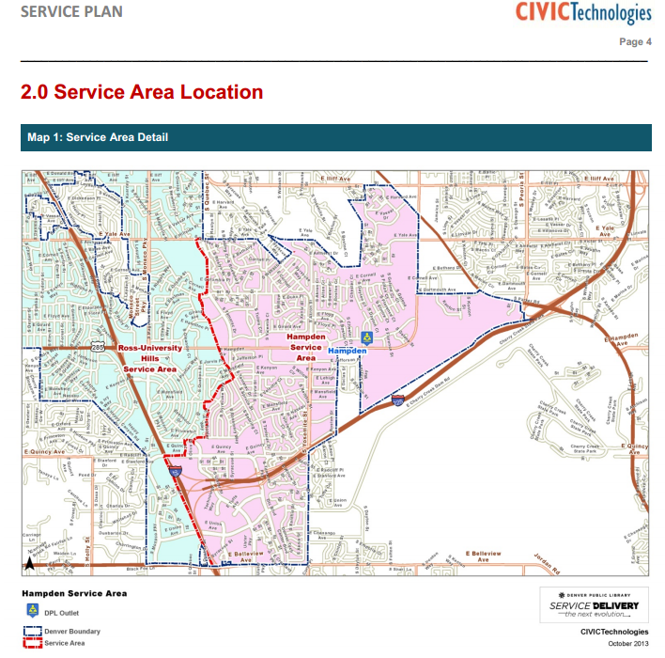
Notes:
Service Delivery: prepared for DPL by CivicTechnologies
Tapestry market segmentation: demographics.
This shows the service areas for two of DPL’s branches.

Slide 7
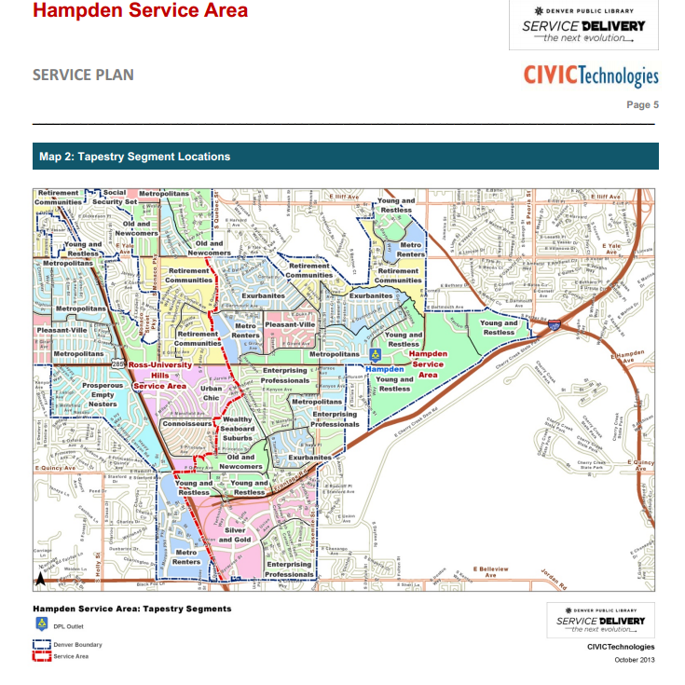
Notes:
This shows who inhabits one branch’s service area.

Slide 8
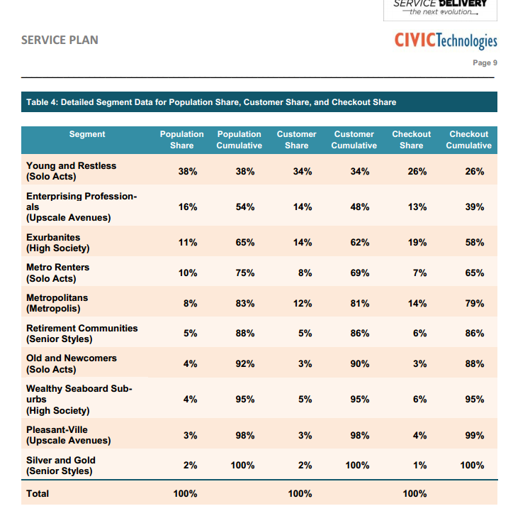
D051029227
Notes:
An example of the different market segments in one branch’s service area. Difference between population share and customer share=people we’re not reaching.

Slide 9
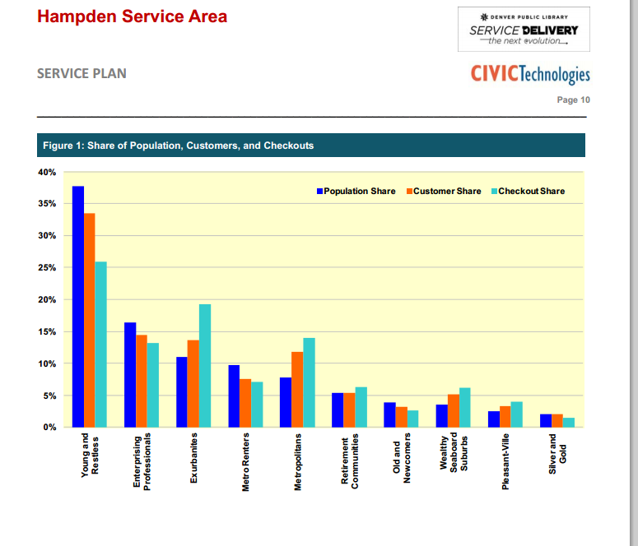
Notes:
Another view of the market shares.

Slide 10
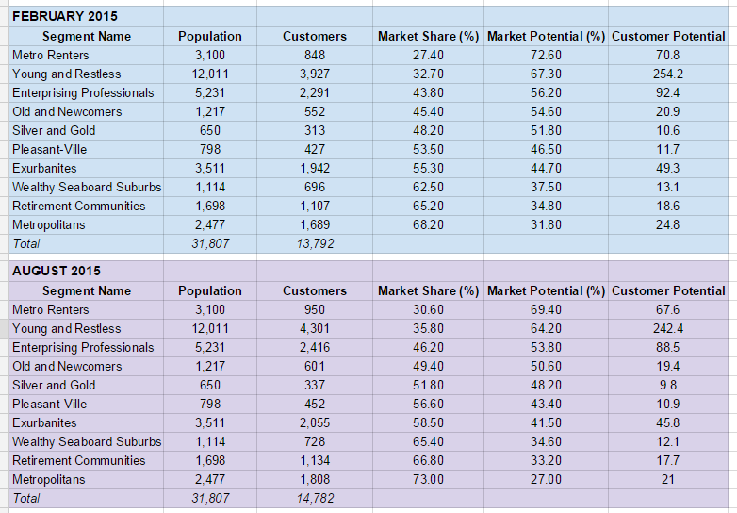
Notes:
An example of how things have shifted in six months at one branch.
Customer Potential is based on an index.

Slide 11
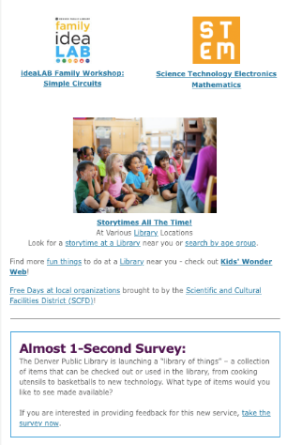
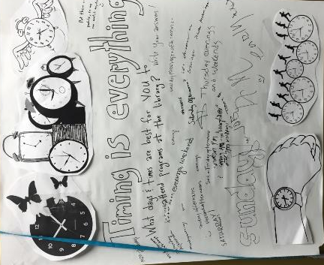
Collecting Data
Notes:
Question of the Month—this one is free and works at any library!
We disseminated the question a number of ways:
1. In person: library staff at each branch could choose one of the following ways to gather data: write the question on a giant sticky note, and patrons write their answers on that, have a notebook at a service desk for patrons to record their answers (or for a staff member to record what the patron said to them), or bribe patrons with stickers and candy if they answer the question (works well with children). Different methods for different user populations.
2. Via social media and one-second surveys. The one-second survey was added to the bottom of DPL’s monthly email newsletter—a link went to SurveyMonkey and consisted of 2 radio buttons. This worked for the binary questions that we had (which were about half of our monthly questions). Great reach, great number of responses. Downside: we couldn’t tell which branch(es) those responders go to.
When figuring out what question to ask, we figured out what we really wanted to know and worked backwards to get the questions (example: I want to know about which area organizations we could potentially have a successful partnership with. So I asked patrons where they like to hang out when they’re not at the library).
Lessons learned for surveying:
1. If you think your question is crystal-clear: still run it by a handful of people who are not library staff before proceeding.
2. Have a controlled vocabulary or a way of eliminating ambiguity for certain kinds of questions. Example: we asked patrons which time and day of the week they preferred for programs. At my branch, I created a grid so that each patron could simply place a dot sticker on whichever hour and day they preferred. Some branches did not do that, so we got answers like “afternoon” or “evening”. This meant that we had to either choose to guess the exact hour(s) that those responders would have chosen, throw out their answers, or create two grids when collecting the responses: one for all of the responses that included exact days and times, and one for the more vague answers.
For other kinds of questions, though (the free-response ones), we chose not to limit people.
3. Some people will choose to answer not the question that you have asked, but the question they wish they had been asked. I collected those answers in a separate file.
4. If you work at a multi-branch library system, make sure everyone is using the same wording for the question.

Slide 12
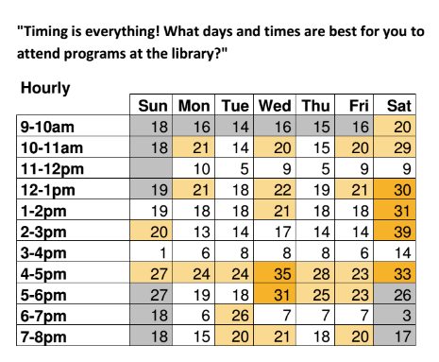
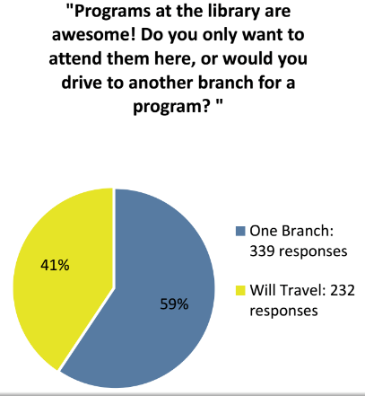
Results
Notes:
Outcomes: there were some themes. People wanted health/fitness classes. The social aspect was important to them. And they wanted “series” rather than one-off events (things like writing clubs, where they would meet once a week or month and write together were common responses).
Saturday afternoons were the most popular choice for programs—this can create a different problem in multi-branch systems: when everyone starts booking programs for 2 pm on Saturdays, does it dilute the audience?
People were more likely to indicate that they travel to other branches if they are from more affluent areas (makes sense: people who can’t afford a car are limited to walking/taking the bus).

Slide 13
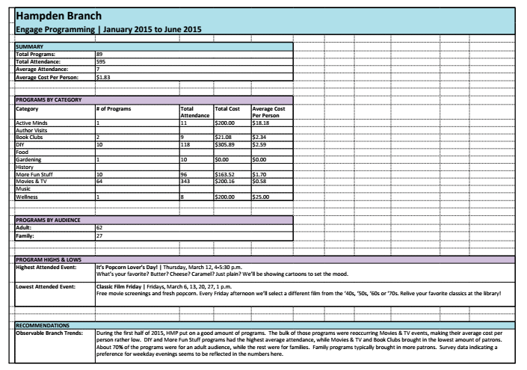
Evaluation
Notes:
We combined the market segmentation, survey results, and programming statistics into The Great Statistical Analysis!
-Programming statistics were pulled from TrackVia. You could keep track of attendance, etc in a spreadsheet if a product like TrackVia is not feasible for your library.
-Includes recommendations for types of programs to try/drop.
Tried-and-true programs: Monica Kadillak (cooking demos with samples), Active Minds
“Success” is variable! Depends on size of library, meeting space.

Slide 14





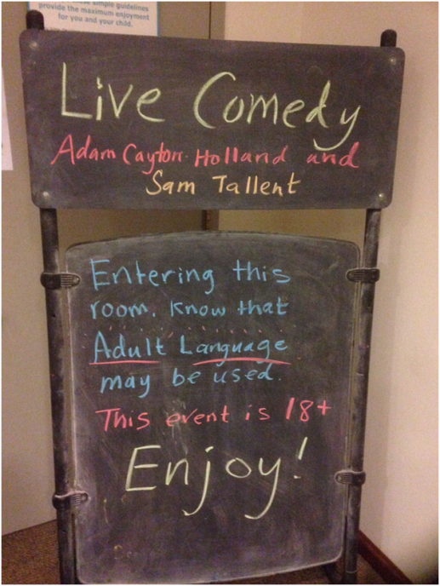
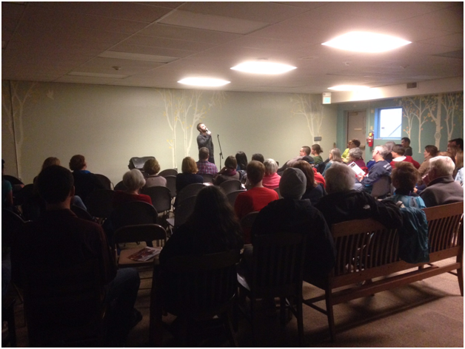
Outcomes
Notes:
Block booking (one point person coordinates programs of a certain type or with a certain organization across all branches): authors, Active Minds, food programs, yoga fitness
2016 crafts = we voted on top crafts based on proposals submitted by programmers. Top crafts can be scheduled. We’re buying supplies in bulk and sending out the box o’ supplies when each branch has their scheduled craft. Better price, saves staff time.
Partnerships: 5280, Active Minds, Walk with a Doc, Mile High Fitness, Geocaching

Slide 15
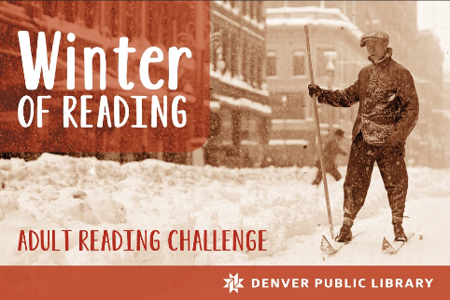
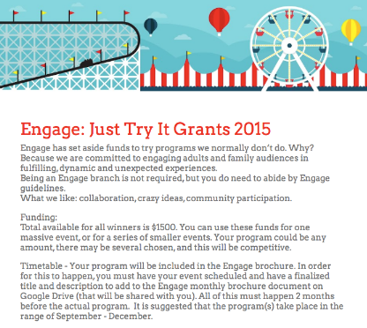

Taking Risks
Notes:
Just Try It grants –people submitted proposals, we voted. The idea was that it would be something outside of our normal offerings.
Winter of Reading –a reading program for adults!
567 completers
398 visited a branch they’d never been to before
125 tried the Personalized Reading Lists
162 checked out an eMedia item; 216 listens at Volume Denver
Netflix—tv binges, movie viewings
BrewHa!Ha!—a celebration of Denver’s maker culture. Partnerships with breweries, tea and coffee shops. Programs with those themes. A comedy show. Discounts when customers flash their library card.

Slide 16
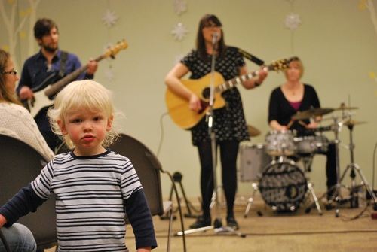
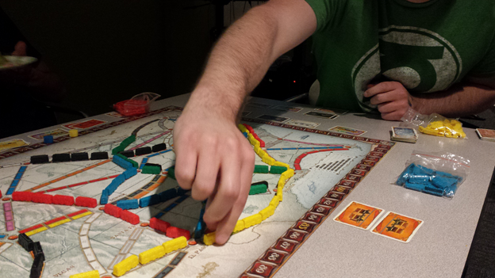
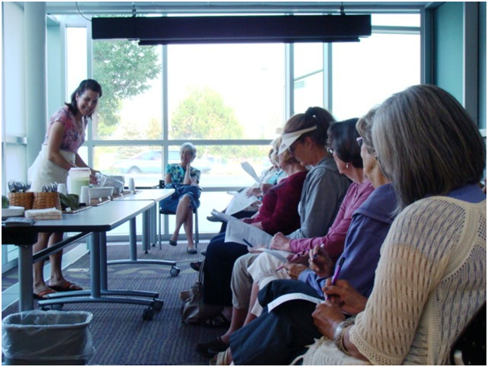
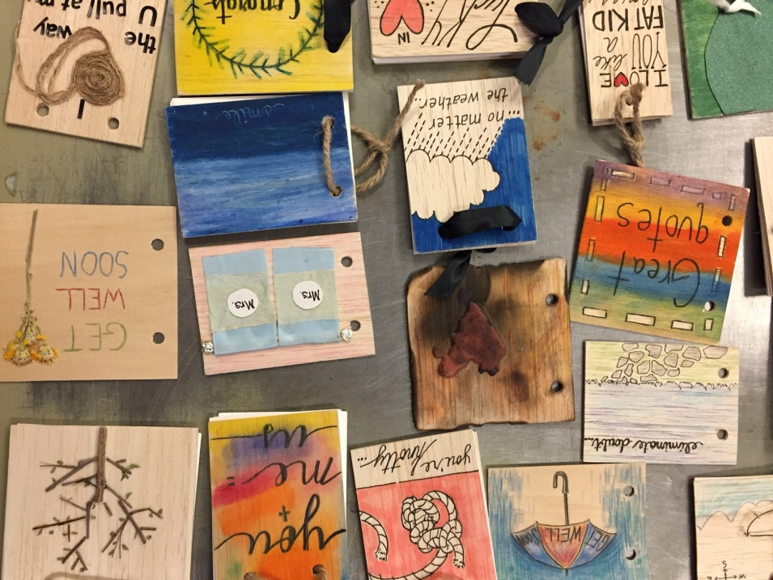
Notes:
Photos from: concert, game night, Monica Kadillak cooking, craft

Slide 17
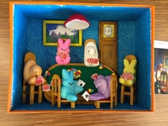
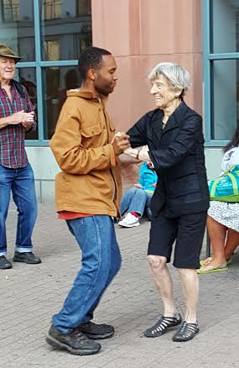
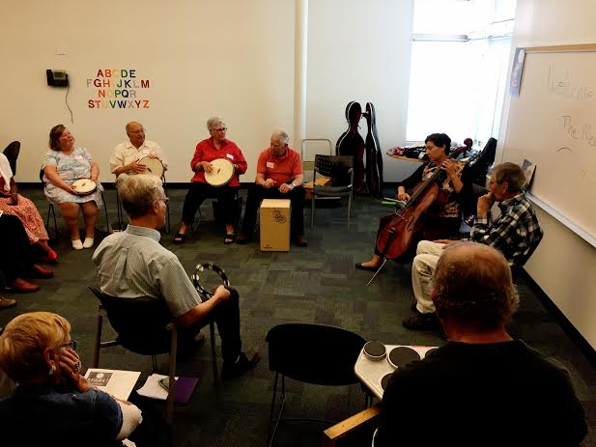
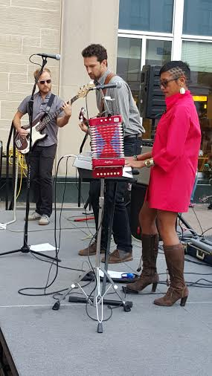
http://www.westword.com/music/video-inside-the-denver-public-librarys-sunrise-concert-for-the-homeless-7148568
Notes:
Sunrise Concert (pop-up concert in partnership with Jaipur and Homeless Action Committee)
Memory Café: social group for people experiencing Alzheimer’s and their caregivers

Slide 18
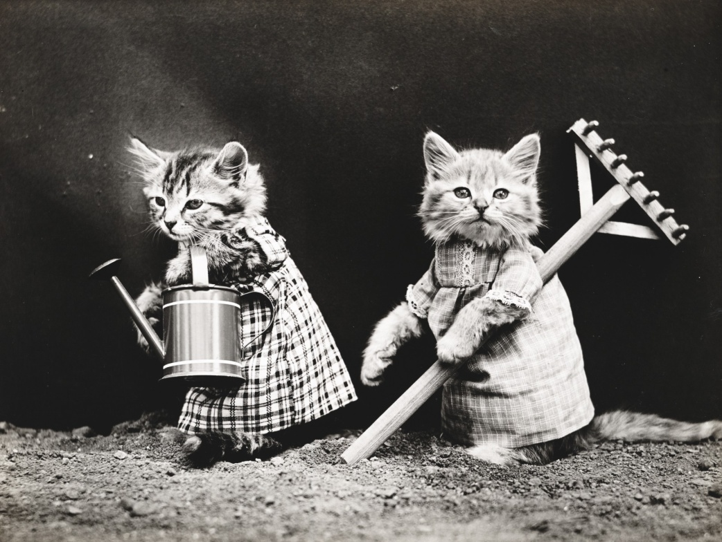
Jenny LaPerriere
jlaperri@denverlibrary.org
Erin Wilkins
  ewilkins@denverlibrary.org
Notes:
Image source: http://www.publicdomainpictures.net/view-image.php?image=75725&picture=cat-dressed-vintage-photo&large=1

